Slide 1
Language Modeling
Introduction to N-grams
“You are uniformly charming!” cried he, with a smile of associating and now
and then I bowed and they perceived a chaise and four to wish for.
Random sentence generated from a Jane Austen trigram model

Slide 2
Probabilistic Language Models
“You are uniformly charming!” cried he, with a smile of associating and now and then I bowed and they perceived a chaise and four to wish for.
Random sentence generated from a Jane Austen trigram model
Notes:
Probabilistic Language Model: Compute the Probability of Sentence or Sequence of words

Slide 3
Probabilistic Language Models
Today’s goal: assign a probability to a sentence
Machine Translation:
P(high winds tonite) > P(large winds tonite)
Spell Correction
The office is about fifteen minuets from my house
P(about fifteen minutes from) > P(about fifteen minuets from)
Speech Recognition
P(I saw a van) >> P(eyes awe of an)
+ Summarization, question-answering, etc., etc.!!
Why?
Notes:
LM can also help in augmentative and alternative communication systems. People often use such AAC devices if they are physically unable to speak or sign but can instead use eye gaze or other specific movements to select words from a menu to be spoken by the system. Word prediction can be used to suggest likely words for the menu.

Slide 4
Probabilistic Language Modeling
Goal: compute the probability of a sentence or sequence of words:
P(W) = P(w₁,w₂,w₃,w₄,w₅…w_{n})
Related task: probability of an upcoming word:
P(w₅|w₁,w₂,w₃,w₄)
A model that computes either of these:
P(W) or P(w_{n}|w₁,w₂…w_{n-1}) is called a language model.
Better: the grammar But language model or LM is standard

Slide 5
How to compute P(W)
How to compute this joint probability:
P(its, water, is, so, transparent, that)
Intuition: let’s rely on the Chain Rule of Probability

Slide 6
Reminder: The Chain Rule
Recall the definition of conditional probabilities
p(B|A) = P(A,B)/P(A) Rewriting: P(A,B) = P(A)P(B|A)
More variables:
P(A,B,C,D) = P(A)P(B|A)P(C|A,B)P(D|A,B,C)
The Chain Rule in General
P(x₁,x₂,x₃,…,x_{n}) = P(x₁)P(x₂|x₁)P(x₃|x₁,x₂)…P(x_{n}|x₁,…,x_{n-1})

Slide 7
The Chain Rule applied to compute joint probability of words in sentence
P(“its water is so transparent”) =
P(its) × P(water|its) × P(is|its water)
× P(so|its water is) × P(transparent|its water is so)

Slide 8
How to estimate these probabilities
Could we just count and divide?
No! Too many possible sentences!
We’ll never see enough data for estimating these

Slide 9
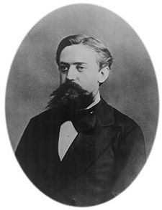
Markov Assumption
Simplifying assumption:
Or maybe
Andrei Markov

Slide 10
Markov Assumption
In other words, we approximate each component in the product

Slide 11
Simplest case: Unigram model
Some automatically generated sentences from a unigram model
fifth, an, of, futures, the, an, incorporated, a, a, the, inflation, most, dollars, quarter, in, is, mass
thrift, did, eighty, said, hard, 'm, july, bullish
that, or, limited, the

Slide 12
Bigram model
Condition on the previous word:
texaco, rose, one, in, this, issue, is, pursuing, growth, in, a, boiler, house, said, mr., gurria, mexico, 's, motion, control, proposal, without, permission, from, five, hundred, fifty, five, yen
outside, new, car, parking, lot, of, the, agreement, reached
this, would, be, a, record, november

Slide 13
N-gram models
We can extend to trigrams, 4-grams, 5-grams
In general this is an insufficient model of language
because language has long-distance dependencies:
“The computer which I had just put into the machine room on the fifth floor crashed.”
But we can often get away with N-gram models

Slide 14
Estimating bigram probabilities
The Maximum Likelihood Estimate

Slide 15

An example
<s> I am Sam </s>
<s> Sam I am </s>
<s> I do not like green eggs and ham </s>

Slide 16
More examples: Berkeley Restaurant Project sentences
can you tell me about any good cantonese restaurants close by
mid priced thai food is what i’m looking for
tell me about chez panisse
can you give me a listing of the kinds of food that are available
i’m looking for a good place to eat breakfast
when is caffe venezia open during the day

Slide 17
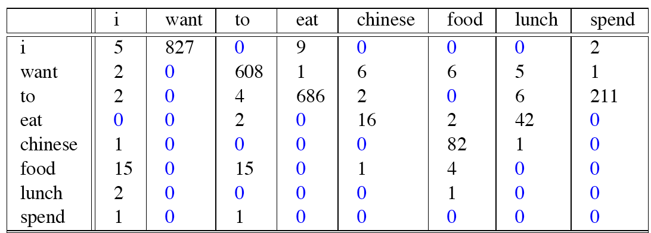
Raw bigram counts
Out of 9222 sentences

Slide 18
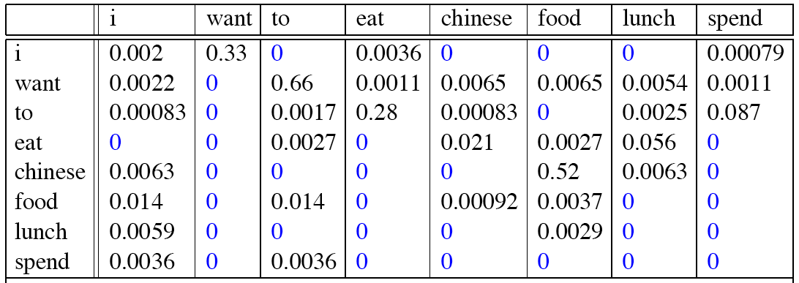
Raw bigram probabilities
Normalize by unigrams:
Result:

Slide 19
Bigram estimates of sentence probabilities
P(<s> I want english food </s>) =
P(I|<s>)
× P(want|I)
× P(english|want)
× P(food|english)
× P(</s>|food)
= .000031

Slide 20
What kinds of knowledge?
P(english|want) = .0011
P(chinese|want) = .0065
P(to|want) = .66
P(eat | to) = .28
P(food | to) = 0
P(want | spend) = 0
P (i | <s>) = .25

Slide 21
Practical Issues
We do everything in log space
Avoid underflow
(also adding is faster than multiplying)

Slide 22
Language Modeling Toolkits
SRILM
http://www.speech.sri.com/projects/srilm/
KenLM
https://kheafield.com/code/kenlm/

Slide 23
Google N-Gram Release, August 2006
…

Slide 24
Google Book N-grams
http://ngrams.googlelabs.com/

Slide 25
Language Modeling
Estimating N-gram Probabilities

Slide 26
Language Modeling
Evaluation and Perplexity

Slide 27
Evaluation: How good is our model?
Does our language model prefer good sentences to bad ones?
Assign higher probability to “real” or “frequently observed” sentences
Than “ungrammatical” or “rarely observed” sentences?
We train parameters of our model on a training set.
We test the model’s performance on data we haven’t seen.
A test set is an unseen dataset that is different from our training set, totally unused.
An evaluation metric tells us how well our model does on the test set.

Slide 28
Extrinsic evaluation of N-gram models
Best evaluation for comparing models A and B
Put each model in a task
spelling corrector, speech recognizer, MT system
Run the task, get an accuracy for A and for B
How many misspelled words corrected properly
How many words translated correctly
Compare accuracy for A and B

Slide 29
Difficulty of extrinsic (in-vivo) evaluation of N-gram models
Extrinsic evaluation
Time-consuming; can take days or weeks
So
Sometimes use intrinsic evaluation: perplexity
Bad approximation
unless the test data looks just like the training data
So generally only useful in pilot experiments
But is helpful to think about.

Slide 30
Intuition of Perplexity
The Shannon Game:
How well can we predict the next word?
Unigrams are terrible at this game. (Why?)
A better model of a text
is one which assigns a higher probability to the word that actually occurs
mushrooms 0.1
pepperoni 0.1
anchovies 0.01
….
fried rice 0.0001
….
and 1e-100
I always order pizza with cheese and ____
The 33rd President of the US was ____
I saw a ____

Slide 31
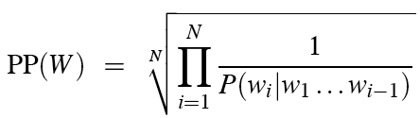
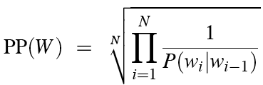
Perplexity
The best language model is one that best predicts an unseen test set
Gives the highest P(sentence)
Perplexity is the inverse probability of the test set, normalized by the number of words:
Chain rule:
For bigrams:
Minimizing perplexity is the same as maximizing probability

Slide 32
The Shannon Game intuition for perplexity
From Josh Goodman
Perplexity is weighted equivalent branching factor
How hard is the task of recognizing digits ‘0,1,2,3,4,5,6,7,8,9’
Perplexity 10
How hard is recognizing (30,000) names at Microsoft.
Perplexity = 30,000
Let's imagine a call-routing phone system gets 120K calls and has to recognize
"Operator" (let's say this occurs 1 in 4 calls)
"Sales" (1in 4)
"Technical Support" (1 in 4)
30,000 different names (each name occurring 1 time in the 120K calls)
What is the perplexity? Next slide

Slide 33
The Shannon Game intuition for perplexity
Josh Goodman: imagine a call-routing phone system gets 120K calls and has to recognize
"Operator" (let's say this occurs 1 in 4 calls)
"Sales" (1in 4)
"Technical Support" (1 in 4)
30,000 different names (each name occurring 1 time in the 120K calls)
We get the perplexity of this sequence of length 120Kby first multiplying 120K probabilities (90K of which are 1/4 and 30K of which are 1/120K), nd then taking the inverse 120,000th root:
Perp = (¼ * ¼ * ¼* ¼ * ¼ * …. * 1/120K * 1/120K * ….)^(-1/120K)
But this can be arithmetically simplified to just N = 4: the operator (1/4), the sales (1/4), the tech support (1/4), and the 30,000 names (1/120,000):
Perplexity= ((¼ * ¼ * ¼ * 1/120K)^(-1/4) = 52.6

Slide 34
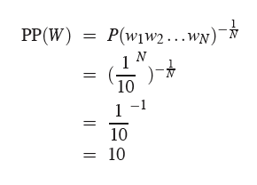
Perplexity as branching factor
Let’s suppose a sentence consisting of random digits
What is the perplexity of this sentence according to a model that assign P=1/10 to each digit?

Slide 35
Lower perplexity = better model
Training 38 million words, test 1.5 million words, WSJ
N-gram Order | Unigram | Bigram | Trigram
Perplexity | 962 | 170 | 109

Slide 36
Language Modeling
Evaluation and Perplexity

Slide 37
Language Modeling
Generalization and zeros

Slide 38
The Shannon Visualization Method
Choose a random bigram
(<s>, w) according to its probability
Now choose a random bigram (w, x) according to its probability
And so on until we choose </s>
Then string the words together
<s> I
I want
want to
to eat
eat Chinese
Chinese food
food </s>
I want to eat Chinese food

Slide 39
Approximating Shakespeare

Slide 40
Shakespeare as corpus
N=884,647 tokens, V=29,066
Shakespeare produced 300,000 bigram types out of V²= 844 million possible bigrams.
So 99.96% of the possible bigrams were never seen (have zero entries in the table)
Quadrigrams worse: What's coming out looks like Shakespeare because it is Shakespeare

Slide 41
The Wall Street Journal is not Shakespeare (no offense)

Slide 42
Can you guess the training set author of the LM that generated these random 3-gram sentences?
They also point to ninety nine point six billion dollars from two hundred four oh six three percent of the rates of interest stores as Mexico and gram Brazil on market conditions
This shall forbid it should be branded, if renown made it empty.
“You are uniformly charming!” cried he, with a smile of associating and now and then I bowed and they perceived a chaise and four to wish for.

Slide 43
The perils of overfitting
N-grams only work well for word prediction if the test corpus looks like the training corpus
In real life, it often doesn’t
We need to train robust models that generalize!
One kind of generalization: Zeros!
Things that don’t ever occur in the training set
But occur in the test set

Slide 44
Zeros
Training set:
… denied the allegations
… denied the reports
… denied the claims
… denied the request
P(“offer” | denied the) = 0
Test set
… denied the offer
… denied the loan

Slide 45
Zero probability bigrams
Bigrams with zero probability
mean that we will assign 0 probability to the test set!
And hence we cannot compute perplexity (can’t divide by 0)!

Slide 46
Language Modeling
Generalization and zeros

Slide 47
Language Modeling
Smoothing: Add-one (Laplace) smoothing

Slide 48
The intuition of smoothing (from Dan Klein)
When we have sparse statistics:
Steal probability mass to generalize better
P(w | denied the)
3 allegations
2 reports
1 claims
1 request
7 total
allegations
attack
man
reports
outcome
…
claims
request
P(w | denied the)
2.5 allegations
1.5 reports
0.5 claims
0.5 request
2 other
7 total
allegations
allegations
attack
man
outcome
reports
…
claims
request

Slide 49
Add-one estimation
Also called Laplace smoothing
Pretend we saw each word one more time than we did
Just add one to all the counts!
MLE estimate:
Add-1 estimate:

Slide 50
Maximum Likelihood Estimates
The maximum likelihood estimate
of some parameter of a model M from a training set T
maximizes the likelihood of the training set T given the model M
Suppose the word “bagel” occurs 400 times in a corpus of a million words
What is the probability that a random word from some other text will be “bagel”?
MLE estimate is 400/1,000,000 = .0004
This may be a bad estimate for some other corpus
But it is the estimate that makes it most likely that “bagel” will occur 400 times in a million word corpus.

Slide 51
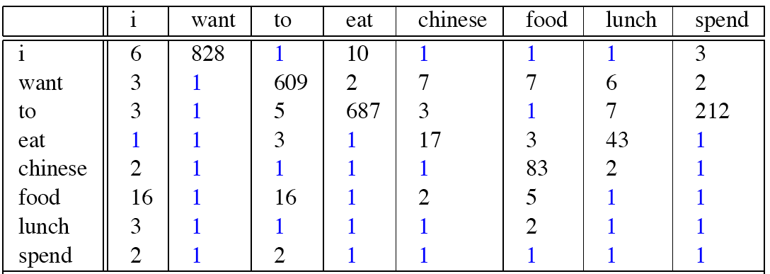
Berkeley Restaurant Corpus: Laplace smoothed bigram counts

Slide 52

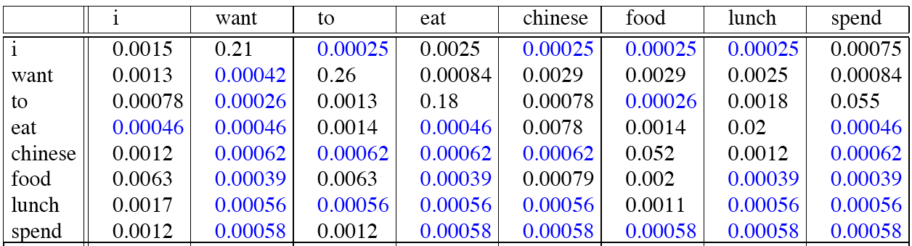
Laplace-smoothed bigrams

Slide 53
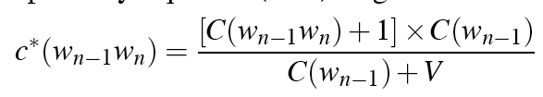
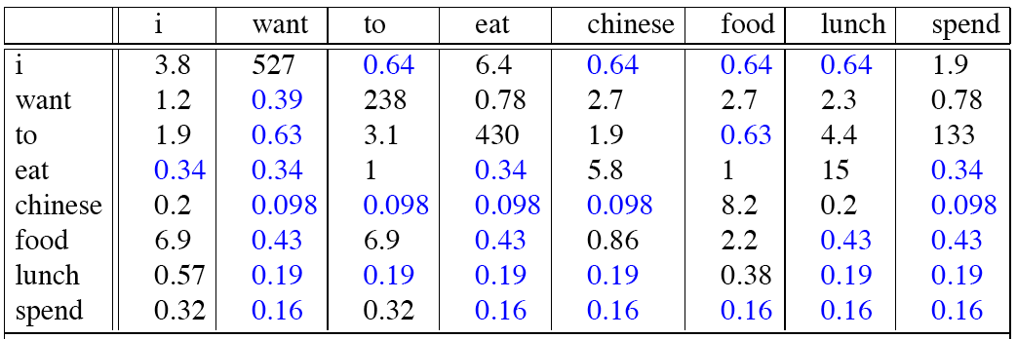
Reconstituted counts

Slide 54
Compare with raw bigram counts
Notes:
C(want to) went from 608 to 238, P(to|want) from .66 to .26!
Discount d= c*/c
d for “chinese food” =.10!!! A 10x reduction

Slide 55
Add-1 estimation is a blunt instrument
So add-1 isn’t used for N-grams:
We’ll see better methods
But add-1 is used to smooth other NLP models
For text classification
In domains where the number of zeros isn’t so huge.

Slide 56
Language Modeling
Smoothing: Add-one (Laplace) smoothing

